Slide 1
Problem Determination and Troubleshooting N4ICP001 — Steve Mirman – Tim Pouyer –Dave Weilert

Slide 2
Legal Notice
Copyright © 2018 by International Business Machines Corporation. All rights reserved.
No part of this document may be reproduced or transmitted in any form without written permission from IBM Corporation.
IBM, the IBM logo, and ibm.com , and IBM Cloud Private are trademarks of International Business Machines Corp., registered in many jurisdictions worldwide. Other product and service names might be trademarks of IBM or other companies. A current list of IBM trademarks is available on the web at “Copyright and trademark information” at ibm.com/legal/copytrade.shtml.
Product data has been reviewed for accuracy as of the date of initial publication. Product data is subject to change without notice. This document could include technical inaccuracies or typographical errors. IBM may make improvements and/or changes in the product(s) and/or program(s) described herein at any time without notice. Any statements regarding IBM's future direction and intent are subject to change or withdrawal without notice, and represent goals and objectives only. References in this document to IBM products, programs, or services does not imply that IBM intends to make such products, programs or services available in all countries in which IBM operates or does business. Any reference to an IBM Program Product in this document is not intended to state or imply that only that program product may be used. Any functionally equivalent program, that does not infringe IBM's intellectually property rights, may be used instead.
THE INFORMATION PROVIDED IN THIS DOCUMENT IS DISTRIBUTED "AS IS" WITHOUT ANY WARRANTY, EITHER OR IMPLIED. IBM LY DISCLAIMS ANY WARRANTIES OF MERCHANTABILITY, FITNESS FOR A PARTICULAR PURPOSE OR NONINFRINGEMENT. IBM shall have no responsibility to update this information. IBM products are warranted, if at all, according to the terms and conditions of the agreements (e.g., IBM Customer Agreement, Statement of Limited Warranty, International Program License Agreement, etc.) under which they are provided. Information concerning non-IBM products was obtained from the suppliers of those products, their published announcements or other publicly available sources. IBM has not tested those products in connection with this publication and cannot confirm the accuracy of performance, compatibility or any other claims related to non-IBM products. IBM makes no representations or warranties, express or implied, regarding non-IBM products and services.
The provision of the information contained herein is not intended to, and does not, grant any right or license under any IBM patents or copyrights. Inquiries regarding patent or copyright licenses should be made, in writing, to:
IBM Director of Licensing
IBM Corporation
North Castle Drive
Armonk, NY 1 0504- 785
U.S.A.

Slide 3


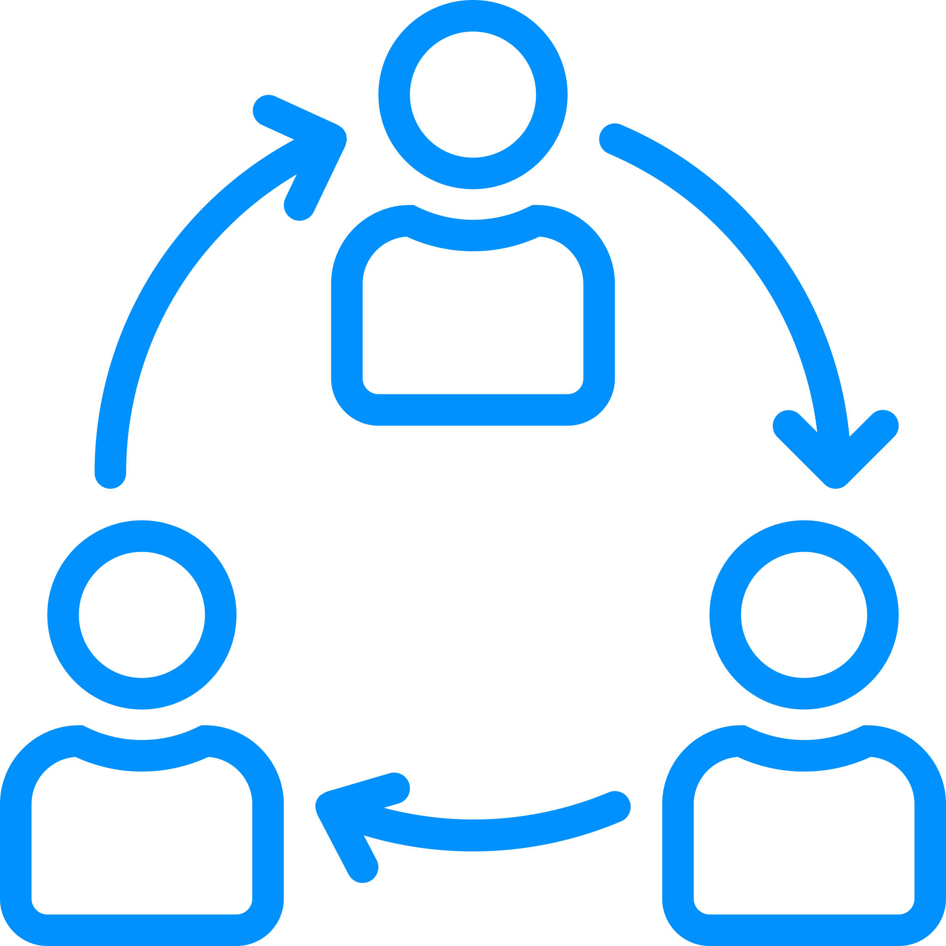
Session Objectives Attendees will be grouped in teams to facilitate collaborative work. Multiple lectures regarding problem determination and troubleshooting will be presented. Following most lectures will be hands-on work that each team collaborates to complete. Review solutions after each lab.

Slide 4
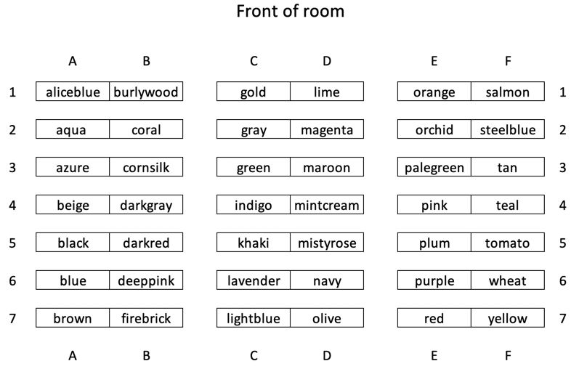
Teams

Slide 5
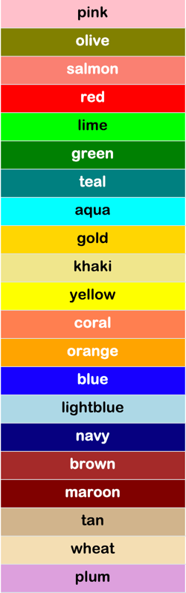
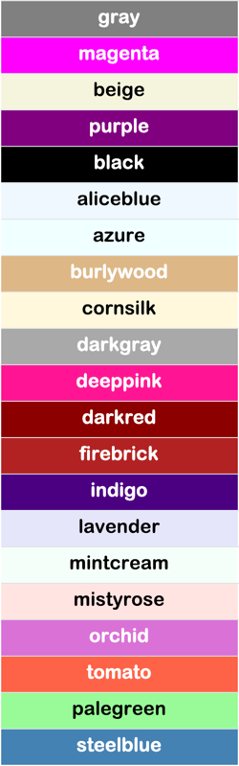
Team Colors
Not in alphabetic
order
Not in alphabetic
order

Slide 6

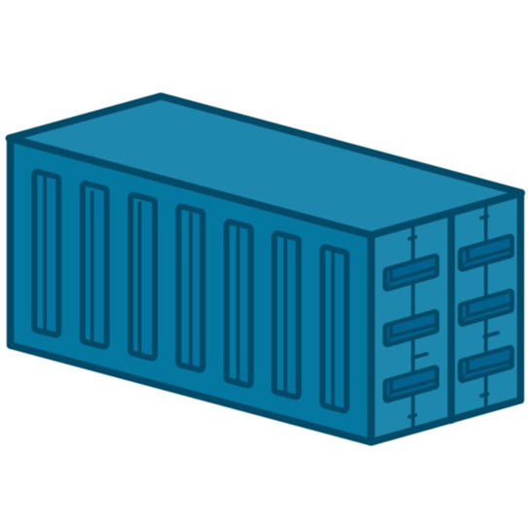
Categories
Container based apps
IBM Cloud Private
Kubernetes
Focus will be on these three categories

Slide 7
Lecture
Tools

Slide 8

Tools in “YOUR” tool kit
We need tools that give us
answers to our questions!

Slide 9
Tools to be used
cloudctl
docker
kubectl

Slide 10
Lab
Installing Tools

Slide 11
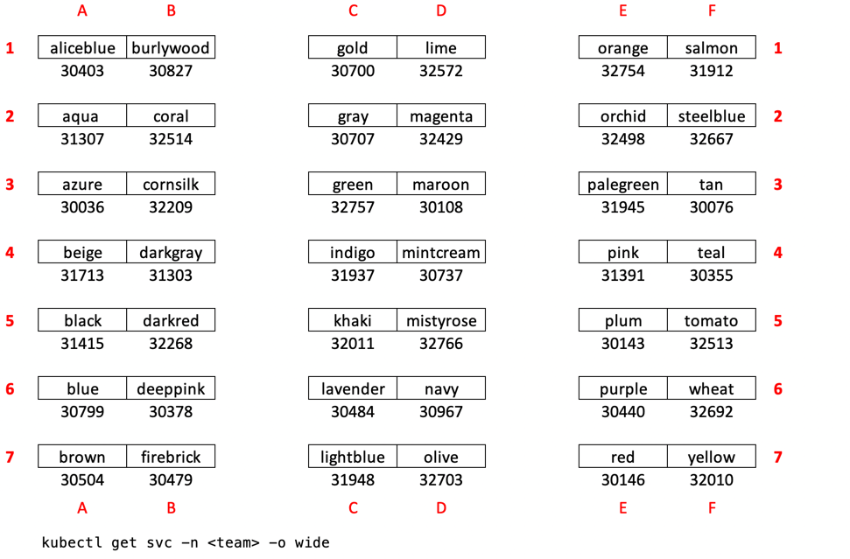
Teams

Slide 12
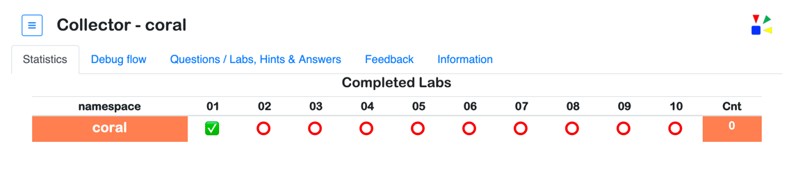
Accessing team web site
http://169.62.220.158:{port#}
Team name and color will be shown
Sequence number
Green checkmark - item is completed
Red circle - item is waiting to be completed

Slide 13

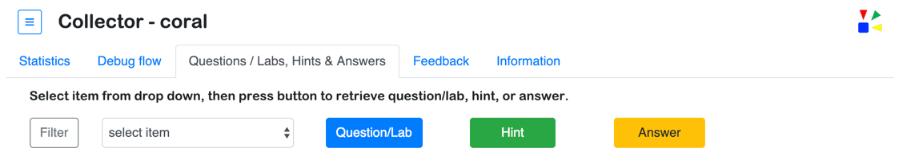
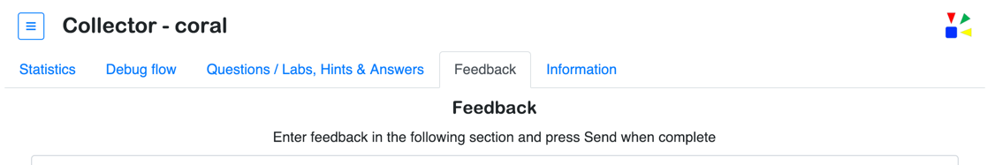
Collector
Tracking items
Button selection and order is tracked
Please provide your feedback

Slide 14
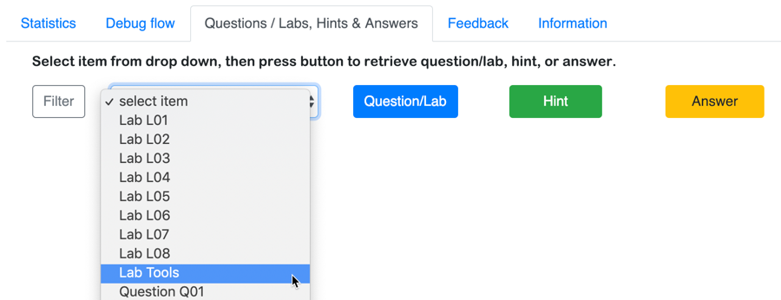
Accessing the lab instructions – Option 1
Step 1: Select tab Questions/Labs & Answers
Step 3: Press Question/Lab button
Step 2: Select item Lab Tools

Slide 15
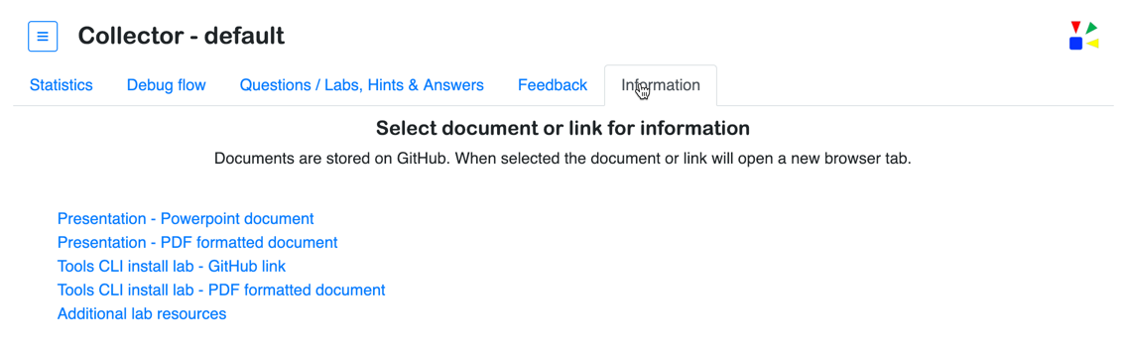
Accessing the lab instructions – Option 2
Step 1: Select tab Information
Step 2: Select Tools CLI install lab (either one)

Slide 16
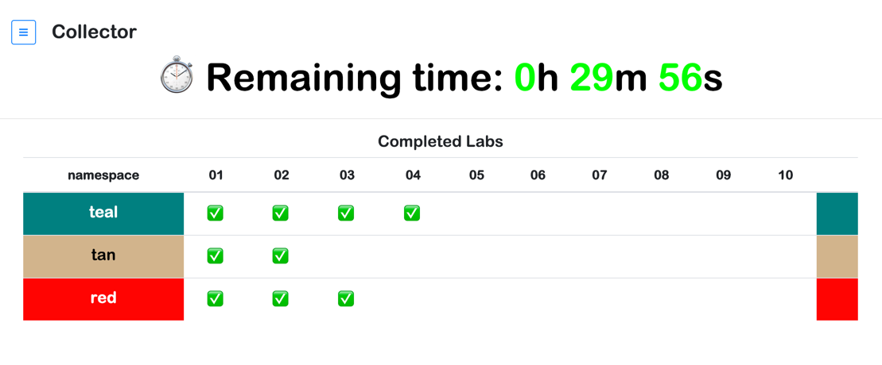
Timing labs
When to stop lab work

Slide 17
Lecture
The “Stack”
&
Kubernetes

Slide 18
Application
Container
Understand the
“stack”
K8 object (pod, deployment, service, etc.)
Container runtime (Docker, Rocket, etc.)
Kubernetes
Network (host, overlay, etc.)
Operating System (Red Hat, Ubuntu, etc.)
Hypervisor (VMWare, Nutanix, etc.)
Hardware (x86, Power, Z)

Slide 19
Components that make up a Kubernetes cluster
Master Components
Node Components
etcd
kube-apiserver
kubelet
kube-proxy
kube-scheduler
kube-controller-manger
container
runtime
Addon Components
IBM Cloud Private
IBM Cloud / © 2019 IBM Corporation

Slide 20
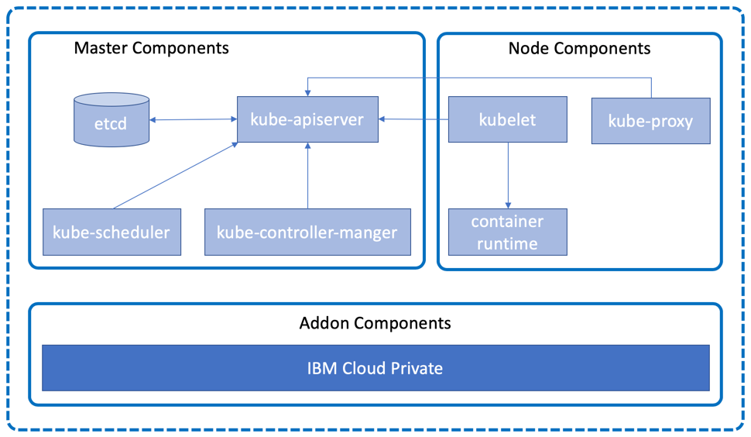
Talking to a cluster
Interact with the cluster through the kubectl command line interface (CLI), which issues REST requests to the Kubernetes kube-apiserver running on the master node.
Local Machine
kubectl

Slide 21
Demo
the Tools

Slide 22
Tools - docker
docker history <image> [--no-trunc ]
docker inspect <image>
docker events (example below grabs a time range)
dstart=$(date "+%Y-%m-%dT%H:%M:%S")
docker run ibmcom/icp-inception:3.1.1
dstop=$(date "+%Y-%m-%dT%H:%M:%S")
docker events --since $dstart --until $dstop
docker run --rm -it --entrypoint=/bin/bash ibmcom/icp-inception:3.1.1
docker stats (will run on a system with multiple containers deployed)

Slide 23
Tools - kubectl
kubectl top [node | pod]
kubectl –n <namespace> get <k8 type>
kubectl –n <namespace> describe <k8 type> <k8 object id>
kubectl –n <namespace> logs [-f] <k8 pod name>
kubectl –n <namespace> exec -it <k8 pod name> [-c <container name>] -- <cmd>
kubectl edit <K8 obj type>/<name>
KUBE_EDITOR="nano" kubectl edit deployment/<name>

Slide 24
Tools - cloudctl
cloudctl login --skip-ssl-validation
- API endpoint> https://169.62.194.213:8443
- Username> admin
- Password> (secret)
- Select a namespace:
(namespaces will be shown with number)
- Enter a number: <enter the number for your team>

Slide 25
Lab
Using the Tools

Slide 26
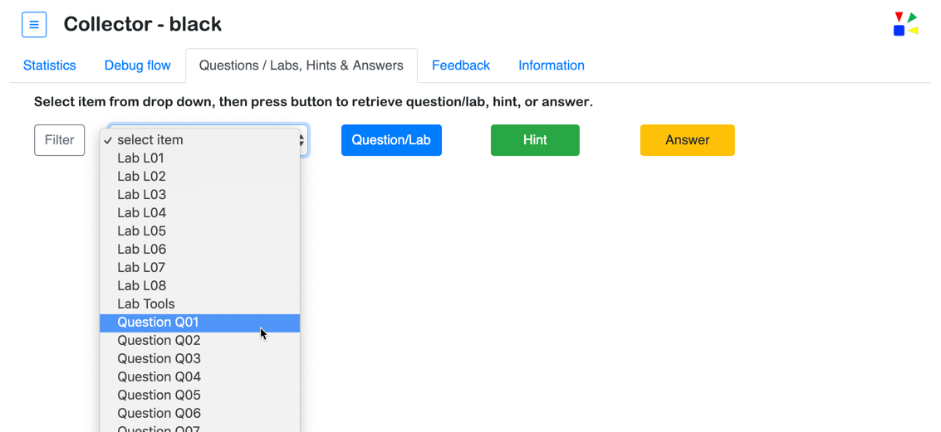
Accessing the Questions
Collector tracks all list selections and button presses to gather information that is used track, understand, and diagnose lab activities
Step 1: Select Question
Step 2
Step 3
Step 4

Slide 27
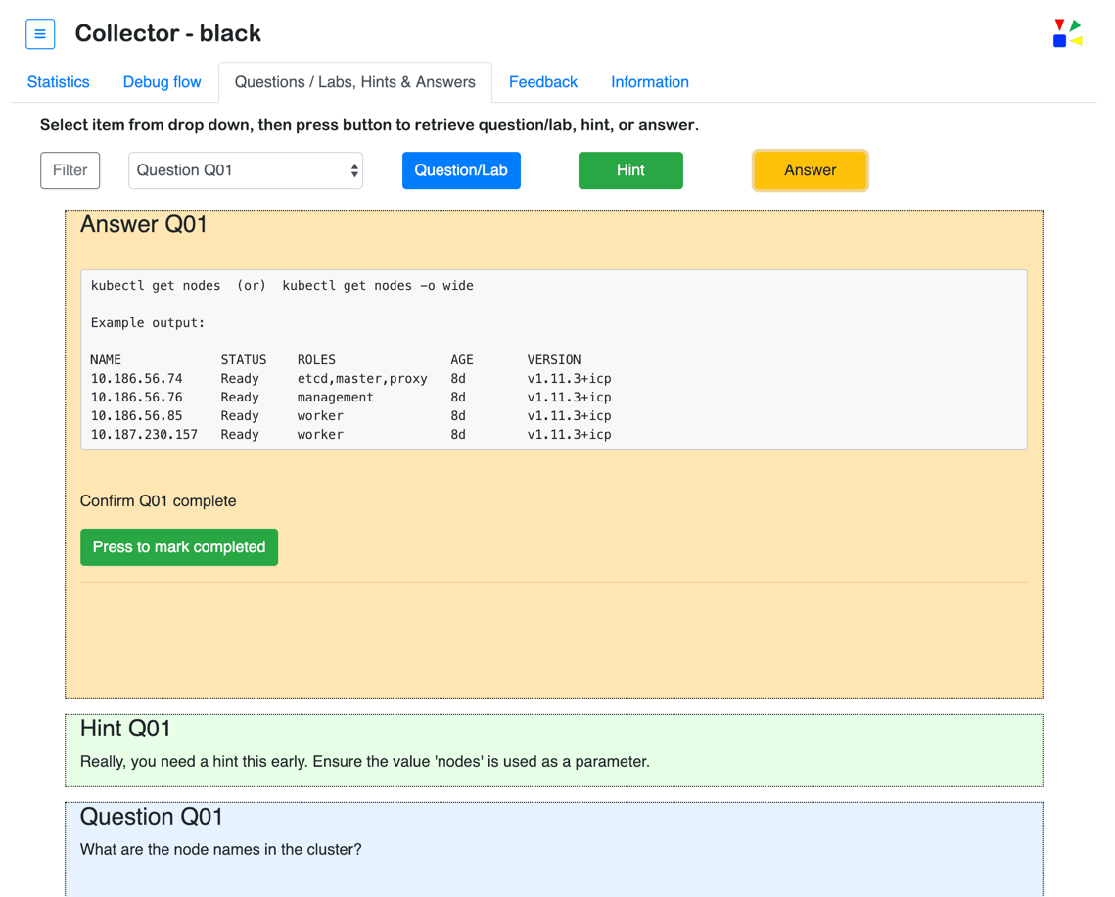
Working to complete the Question
IMPORTANT
Press the button to mark the question as completed
Answer hidden
for demo purposes

Slide 28
Authenticate session using cloudctl
<Open terminal or shell window>
cloudctl login --skip-ssl-validation
- API endpoint> https://169.62.194.213:8443
- Username> admin
- Password> (secret)
- Select a namespace:
(namespaces will be shown with number, select your team)
- Enter a number: <enter the number for your team>

Slide 29
Teams working together to answer the Questions

Slide 30
Lecture
Containers
&
Apps

Slide 31
Components of a container based application
Docker
Build
Push
Run
Stop
Inspect
History
Events
CONTAINER
Application
Bins/Libs

Slide 32
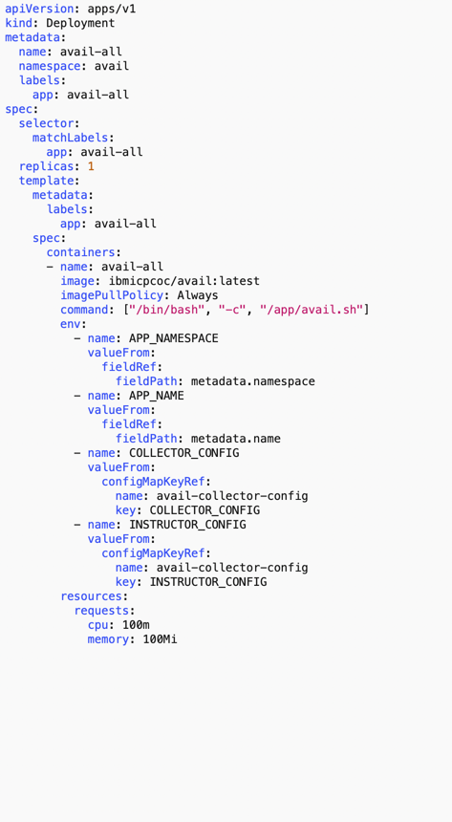
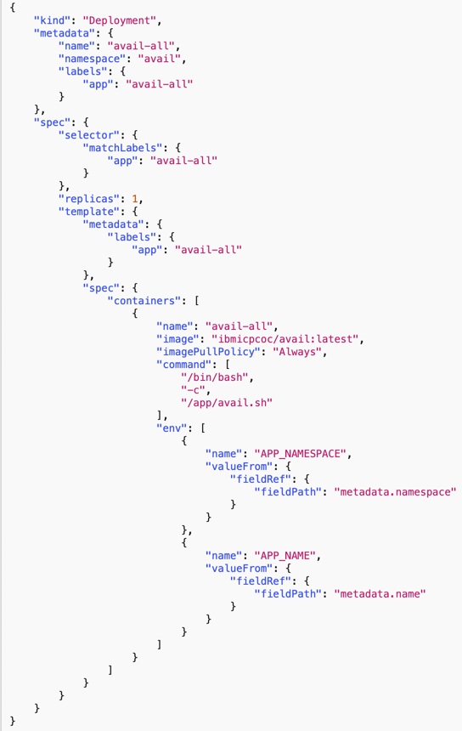
Defining K8 objects
yaml json
Indentation (spaces)
Hyphens
matter
{}
[]
Quotes
Commas
matter

Slide 33
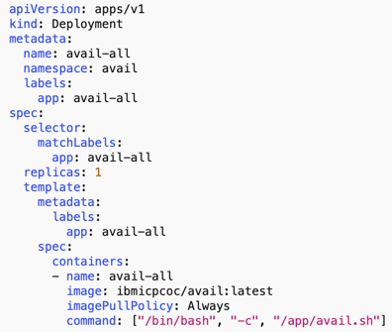
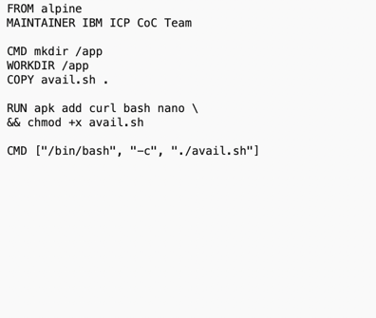
What’s running in the container
k8
docker

Slide 34
Lab
Fixing
stuff that’s
broken

Slide 35
Accessing the Labs
Step 1: Select Lab
Step 2
Step 3
Step 4

Slide 36
Example debug process
Modify object definition?
Kill pod?
Change container resource?
Rebuild container?
Reboot node?
Define or increase storage?
Modify network?
cluster authentication
kubectl get <object>
kubectl describe <object>
kubectl logs –f <pod>
-c <container>
kubectl exec -it <pod> -- cmd
journalctl -xe
ingress
journalctl -u <unit>
docker logs
host network
<object> - pods, service, statefulsets, deployment, etc.
<pod> - pod name
<container> - container name (required if more than one container)
cmd - command to run
<unit> - unit running, e.g. kubelet, docker, etc.
Example actions
overlay network
IBM Cloud / © 2019 IBM Corporation

Slide 37
Don’t forget to check
Security
Networking
Storage
Images
CPU & Memory

Slide 38
Teams working together to complete the Labs

Slide 39
Lecture
ICP

Slide 40
Lab – Instructor Lead
Trouble-shoot
ICP

Slide 41
What’s in ICP?
audit*
auth*
calico*
k8*
key-management*
logging*
metering*
monitoring*
Not a complete list

Slide 42
What’s in ICP?
audit*
auth*
calico*
k8*
key-management*
logging*
metering*
monitoring*
Not a complete list

Slide 43
Teams working together to complete
the ICP Labs

Slide 44

Support
Slack #private-cloud
Intended for quick answers through swarming, especially How To, Known Issues, best practices etc.
Cases can be opened at
https://ibm.biz/icpsupport
If you can’t open a case, please see https://ibm.biz/BdYuiZ

Slide 45
Additional Information
Example of logs to collect
https://github.ibm.com/IBMPrivateCloud/support-tools/blob/master/log_collector/icplogcollector-master.sh
VpK and KubeToy
https://github.com/IBM-ICP-CoC/VpK
https://github.com/IBM-ICP-CoC/KubeToy
50 Useful Kubernetes Tools
https://caylent.com/50-useful-kubernetes-tools/

Slide 46

Get Session Credit
Open up the Fast Start event app
Find this session in your schedule
Session Name: Problem Determination and Trouble Shooting Session ID: 7440
Click on ‘check in’
Enter the code
Don’t forget the session survey!
7440

Slide 47
Thank you
Steve Mirman
Chief Architect – IBM Cloud Private Center of Competency, NA
—
samirman@us.ibm.com
Tim Pouyer
Global DevOps Deploy & Release Automation Practice Lead
—
tpouyer@us.ibm.com
Dave Weilert
Executive Architect – IBM Cloud Private Center of Competency, NA
—
daveweilert@us.ibm.com

Slide 48

Meetup Information (starter kit & training) http://ibm.biz/meetup-kit http://ibm.biz/meetup-training Recorded Lunch and Learn http://bit.ly/social-lnl DTE Social Handles (on ZACs) http://ibm.biz/dte-social IBM Cloud Social Handles http://ibm.biz/cloud-social DTE Blog Calendar http://ibm.biz/blog-calendar Social Selling Badges https://ibm.co/2yGFm00
Learn more about your IBM Community & Social Selling
Social Tips & Tricks Videos (pinned in #dte-social Slack channel) https://bit.ly/linked-profile https://bit.ly/linked-headline http://bit.ly/link-communities Community Videos (pinned in #IBMCommunity Slack channel) http://ibm.biz/community-intro http://ibm.biz/community-groups http://ibm.biz/community-notification

